Slide 1
Design Science Research
Dirk Riehle, Univ. Erlangen
NYT B04
Licensed under CC BY 4.0 International

Slide 2
Agenda
A short research history
Design science research

Slide 3
1. A Short SE Research History

Slide 4
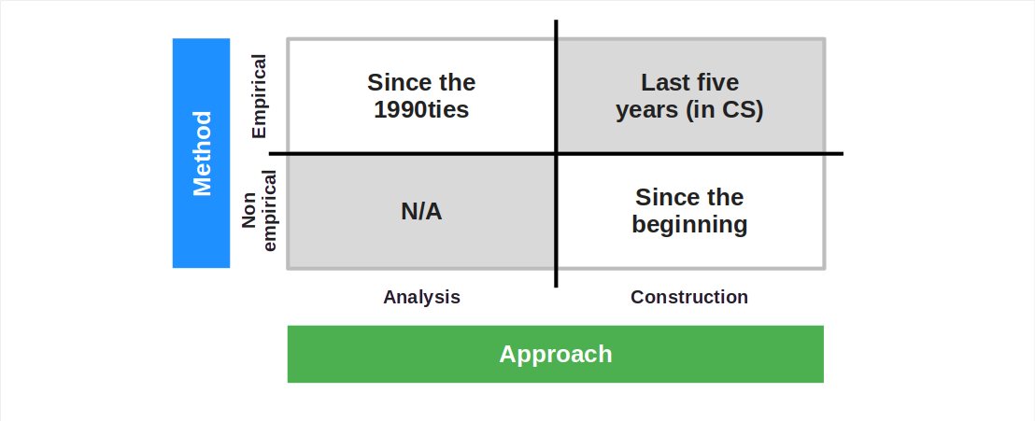
A Short Research History

Slide 5
1. Software Engineering Research of Old
Engineering is building artifacts
Engineering science (research) is building-to-learn
Building-to-learn was often only casually or not at all evaluated

Slide 6


Empirical Software Engineering
Victor R. Basili, Ph.D.

Slide 7
2. (Overly) Analytical Software Engineering Research
Fastest way to research paper
Formulate hypothesis
Test with GitHub data
Write and submit paper

Slide 8
3. Design Science Research
Empirically grounded innovation

Slide 9
2. Design Science Research

Slide 10
Design Science Research [1]
Design science is a
Paradigm for conducting scientific research
Methodology if you follow a specific textbook
The goal of design science research is to
Find innovative solutions to current problems
[1] Paradigm = methodology category

Slide 11
Design Science Research [1] Activities and Their Purpose
# | Activity | Purpose
1. | Problem identification | Build theory of problem domain
2. | Objective definition | Define objective (“research question”)
3. | Solution design | Design solution (the “design science artifact”)
4. | Demonstration | Demonstrate viability (should we continue?)
5. | Evaluation | Evaluate theory as embodied in artifact
6. | Publication | Communicate findings
[1] According to Peffers et al. (2007)

Slide 12
What’s Scientific About Design Science Research?
Problem identification
Theory building methodologies
Structured literature survey
Qualitative survey
Questionnaire
Research methods
Qualitative data analysis
QDA associated practices
Evaluation / validation
Theory building methodologies
Action research
Case study research
…
Hypothesis testing
Controlled experiments
Hypothesis testing surveys

Slide 13
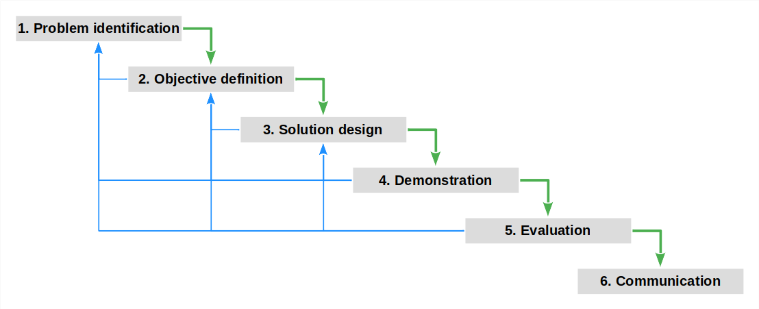
Iteration in Design Science Research

Slide 14
Design Science and Engineering Theses
# | Design Science Activity | Final Thesis
1. | Problem identification | Related work
2. | Objective definition | Requirements for work
3. | Solution design | Design and implementation
4. | Demonstration | Demonstration
5. | Evaluation | Evaluation against requirements
6. | Publication | Final thesis

Slide 15
Where Effort is Spent in Design Science Research [1]
# | Activity | % (Master Thesis) | % (Ph.D. Thesis)
1. | Problem identification | 4% | 29%
2. | Objective definition | 1% | 1%
3. | Solution design | 70% | 20%
4. | Demonstration | 15% | 5%
5. | Evaluation | 0% | 35%
6. | Publication | 10% | 10%
[1] According to me, spitballing… [DR]

Slide 16
Thank you! Any questions?
dirk.riehle@fau.de – https://oss.cs.fau.de
dirk@riehle.org – https://dirkriehle.com – @dirkriehle

Slide 17
Legal Notices
License
Licensed under the CC BY 4.0 International license
Copyright
© 2012, 2023, 2024 Dirk Riehle, some rights reserved

